Slide 1

Calypso X Performance
-Trying to display data that shows IOPS and Quality of Service

Slide 2
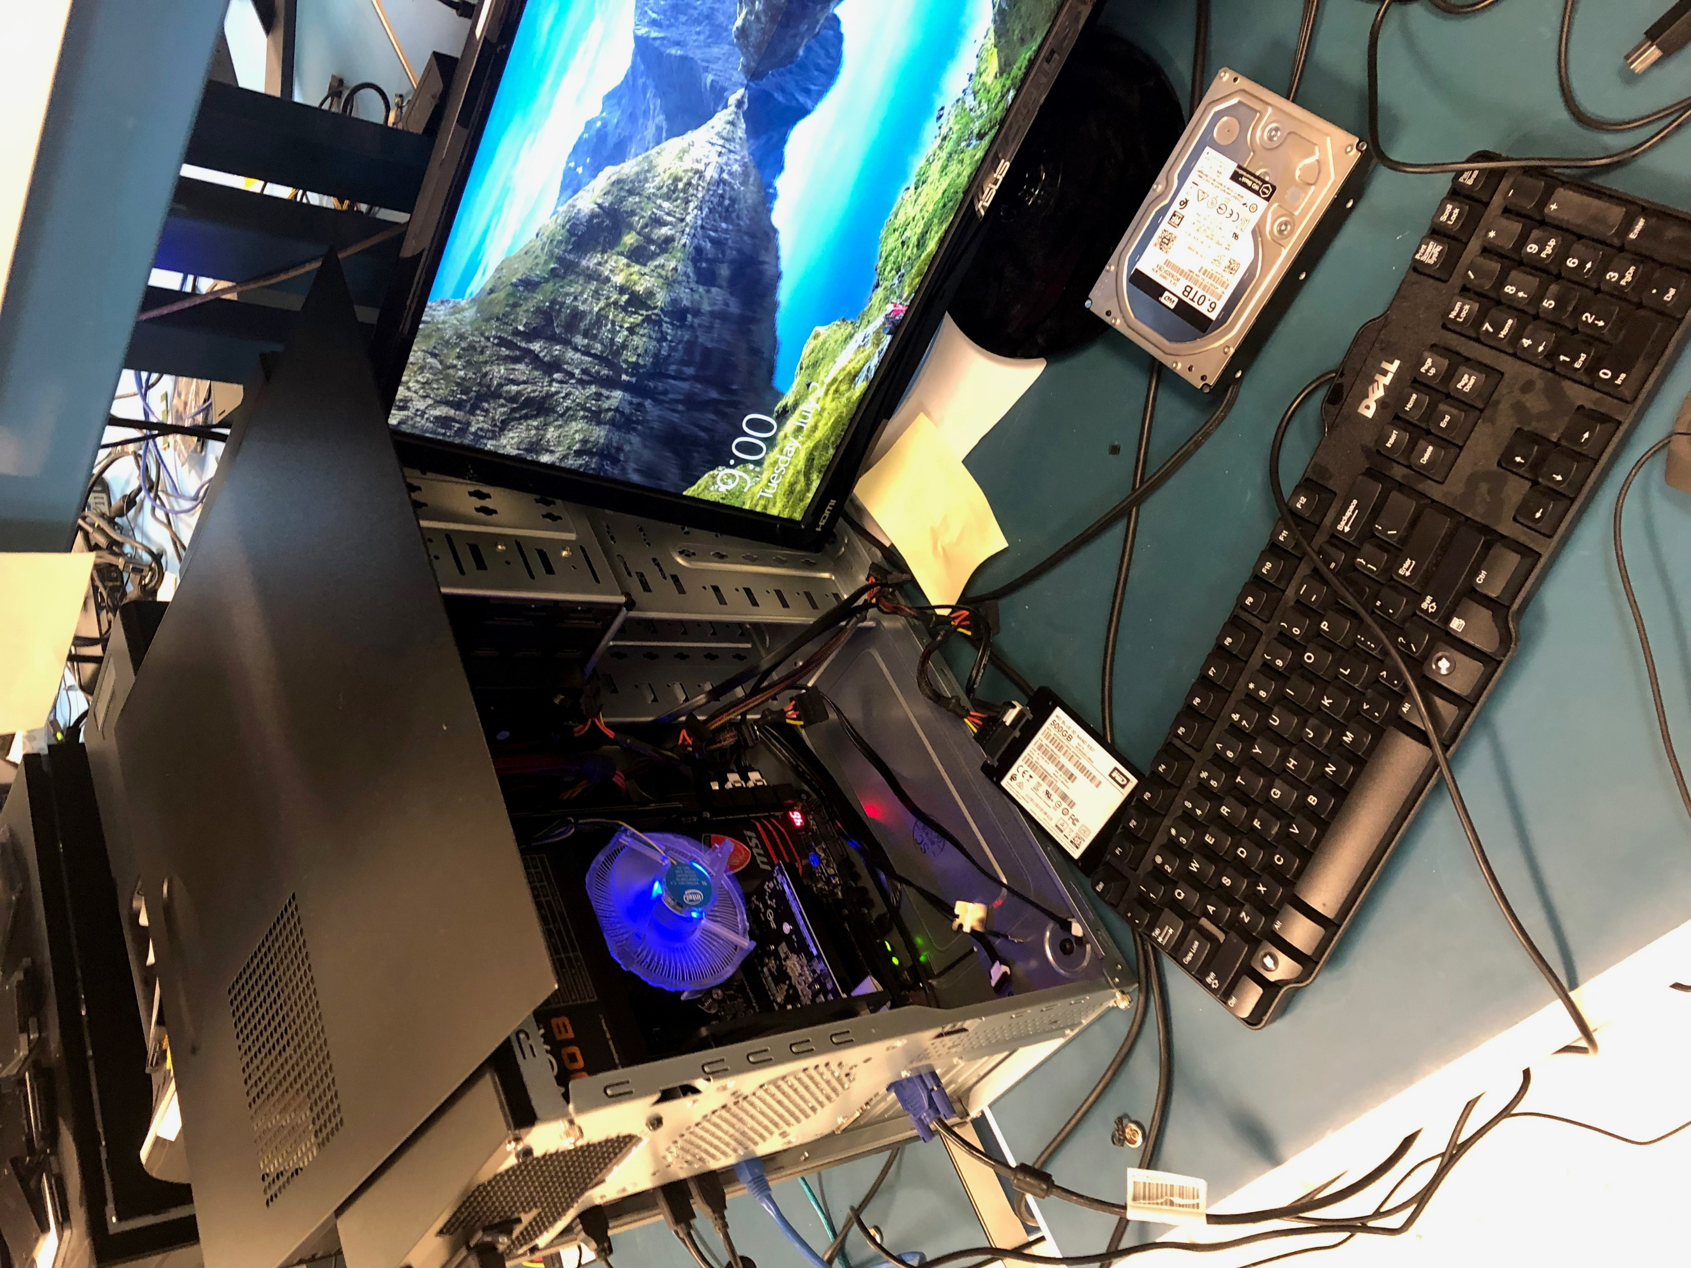
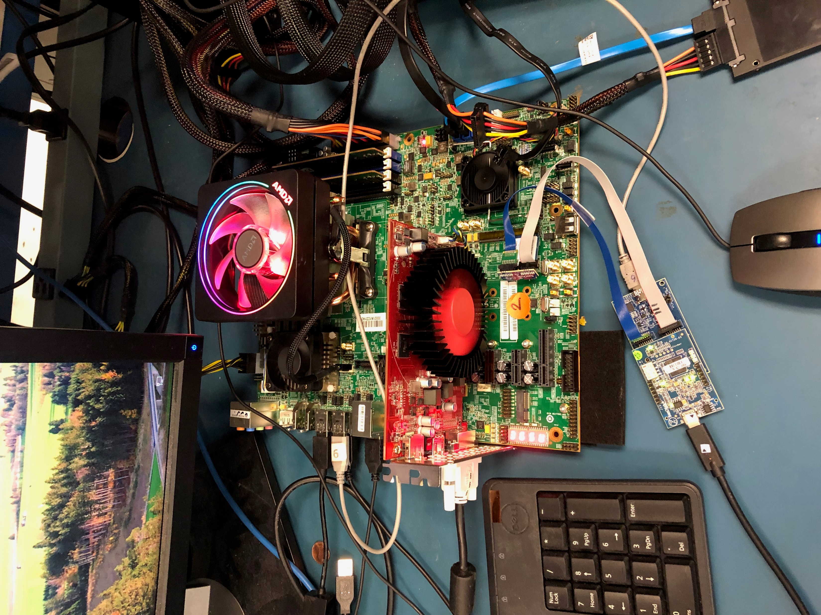
Test Environment
Left PC: captures SET events from informer board
Right PC: runs diskspd test from Microsoft

Slide 3

xPlorer
Using xPlorer to start collecting and converting RWR files
Ran xbox test for 7 mins
xPlorer took 3 hrs to translate the RWR files
Produced around 9,000,000 SET events
Using xPlorer’s filter, 7,000,000 SET events produced in 1 hr
Like “name like “Command Comletion”
Converting to a csv file 700mb file
Python takes 15 seconds to run IOP script on 7,000,000 SET events
Python takes 49 seconds to run QOS script on 7,000,000 SET events
Possible solution: Using plugin (Java), using spotfire instead of excel
Limitations:
1. SET Event names are not uniform

Slide 4
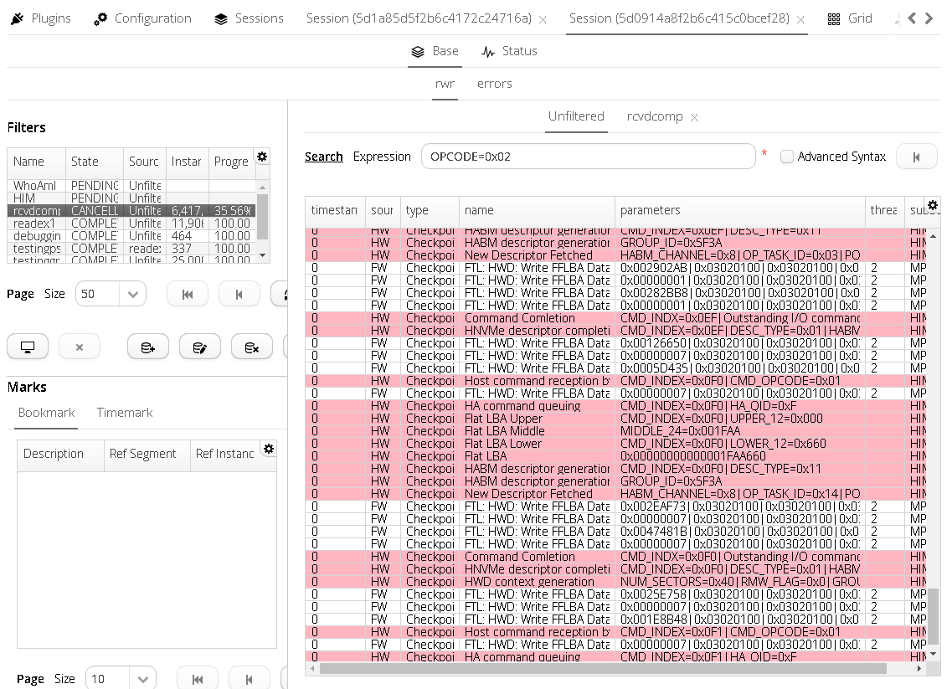
Example session

Slide 5
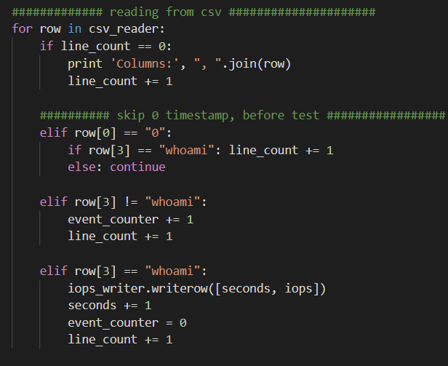
Scripts: IOPS
IOPS
Uses “whoami” flag as markers for each second
Can be refined by using the global timestamp for smaller time units like milliseconds
*Initially used a data structure to store result but can save space by directly writing to a csv file

Slide 6
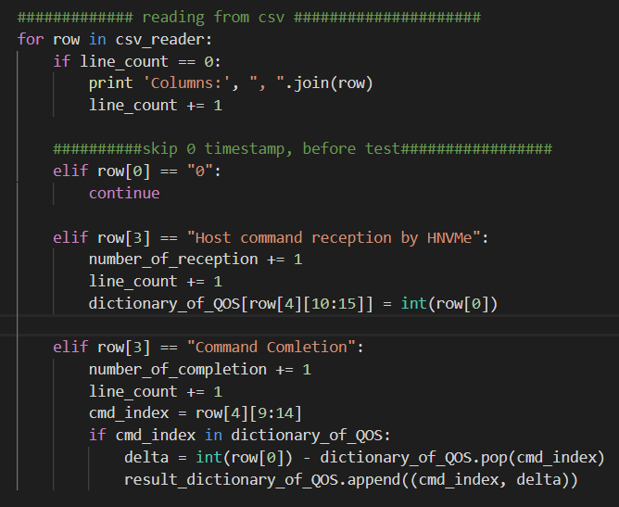
Scripts: QOS (simple)
Simple:
Only uses the Command Received & Command Completion
Doesn’t include, FE, FTL, PS, HW

Slide 7
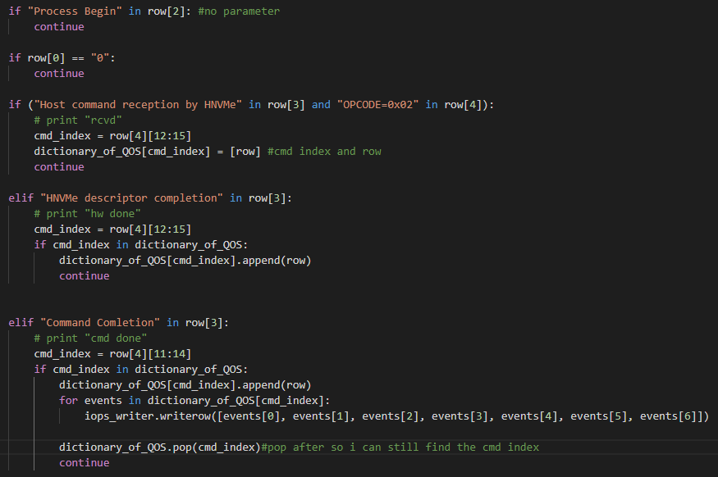
Scripts: QOS (detailed)
Hard Coded
1. cmd rcvd
2. descriptor completion
3. cmd comletion

Slide 8
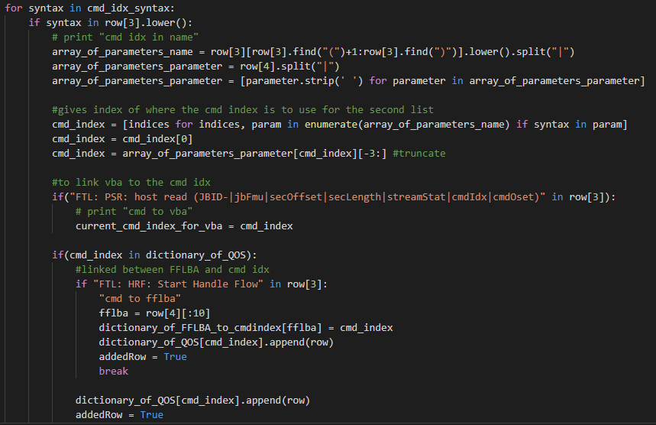
Scripts: QOS (detailed) continued…
Looking for SET events with
1. cmd idx
2. cmdidx
Also
1. links next PSR: VBA to the current command index (explained in next slide)
2. looks for start of FTL

Slide 9
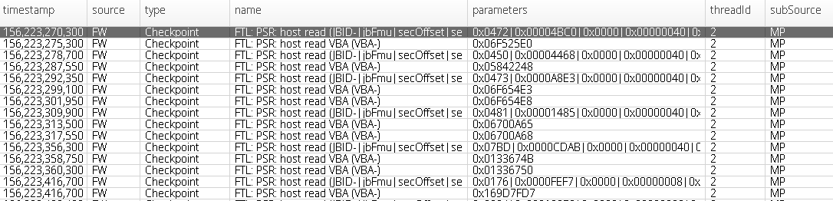
Scripts: QOS (detailed) continued…
As shown above the next VBA’s are connected to the initial PSR host read with the big parameter
IN SEQUENCIAL ORDER

Slide 10
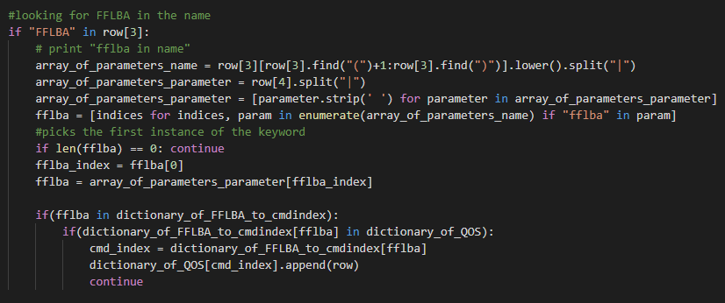
Scripts: QOS (detailed) continued…
Finds FTL events that links the FFLBA to the original command index

Slide 11
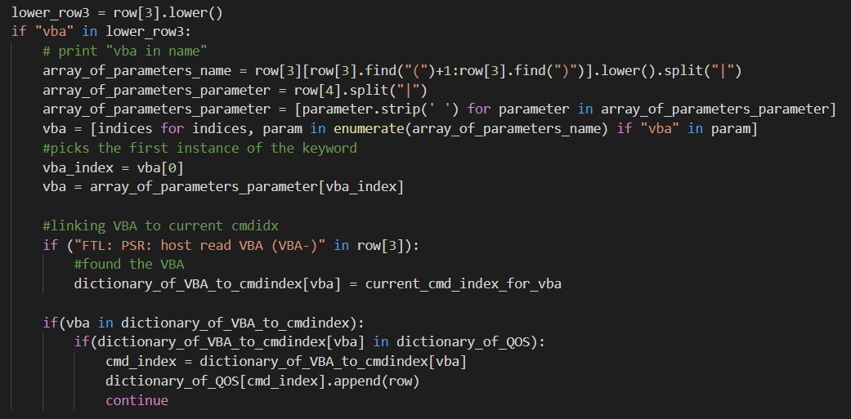
Scripts: QOS (detailed) continued…
Finding all PS events with VBA’s that link to the original command index

Slide 12
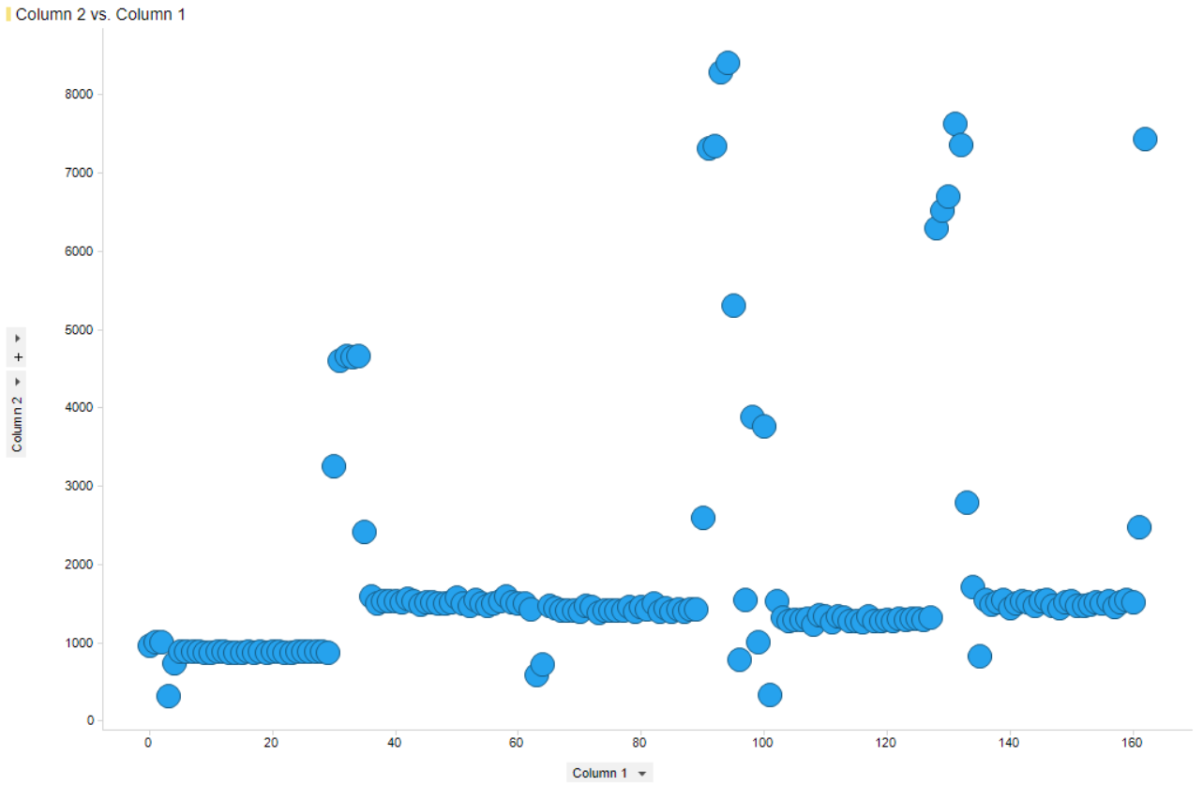
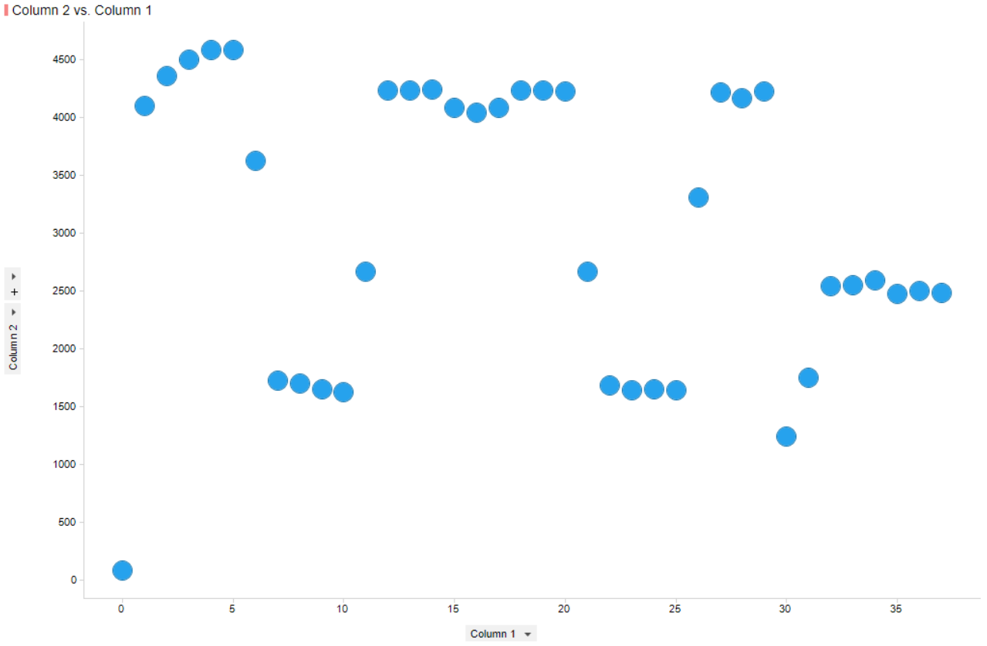
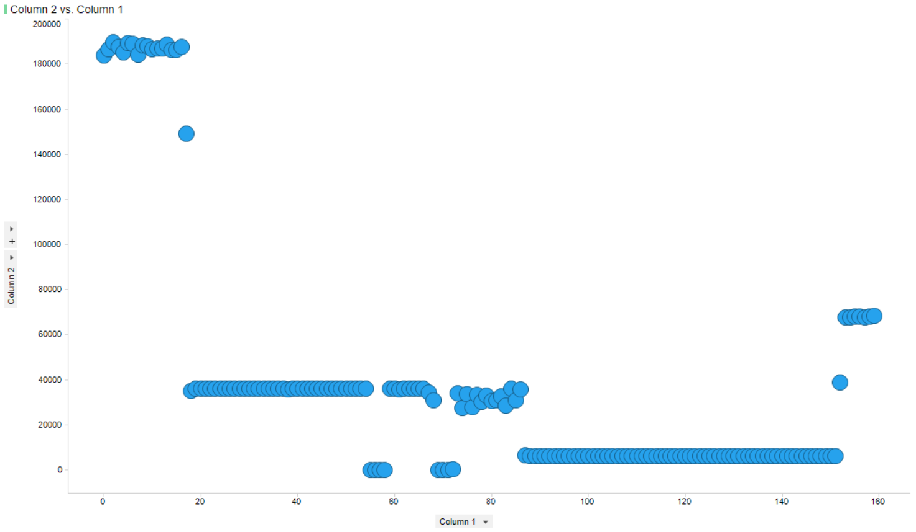
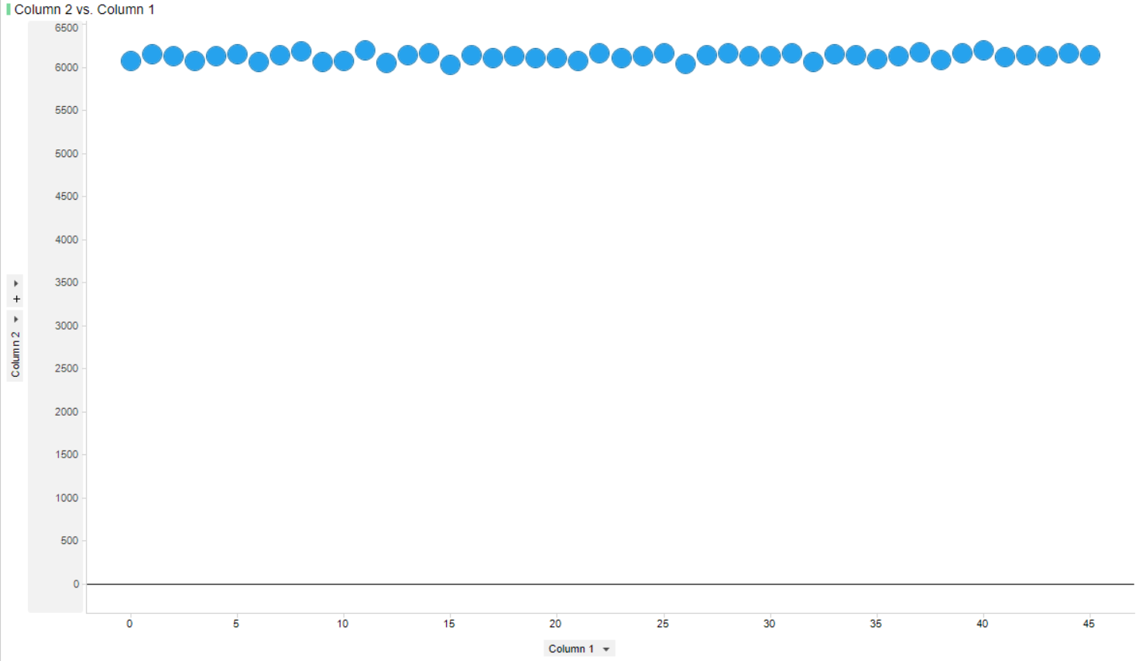
Result of Scripts: IOPS
Test 1 – CVF FVT test
Test 2 – CVF FVT test
Big File
Xbox 30 secs

Slide 13
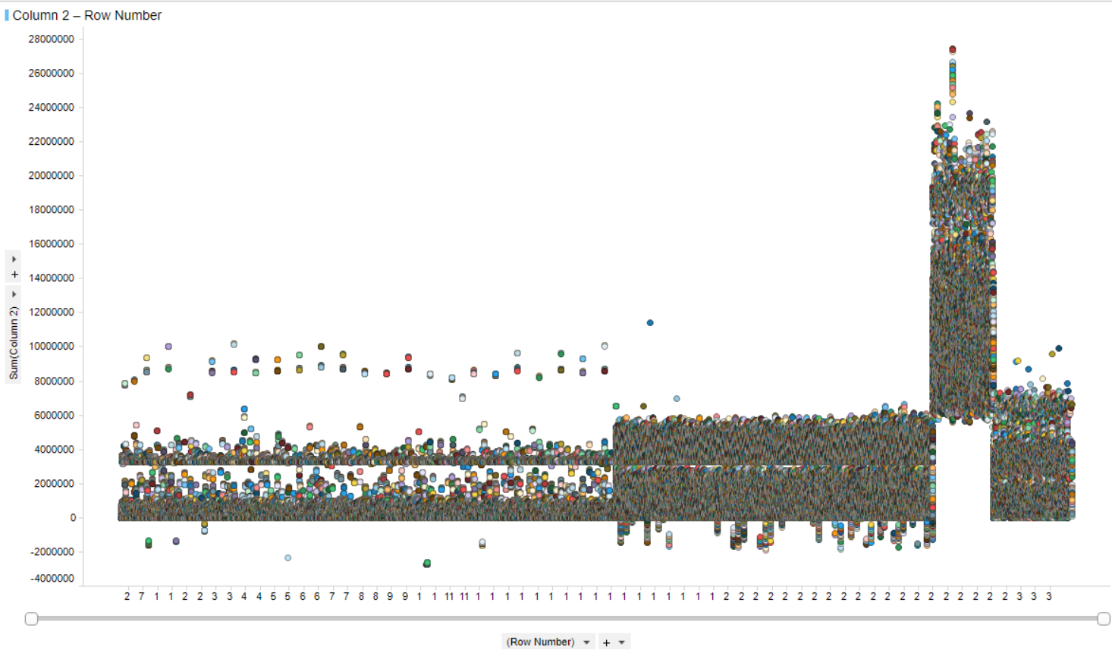
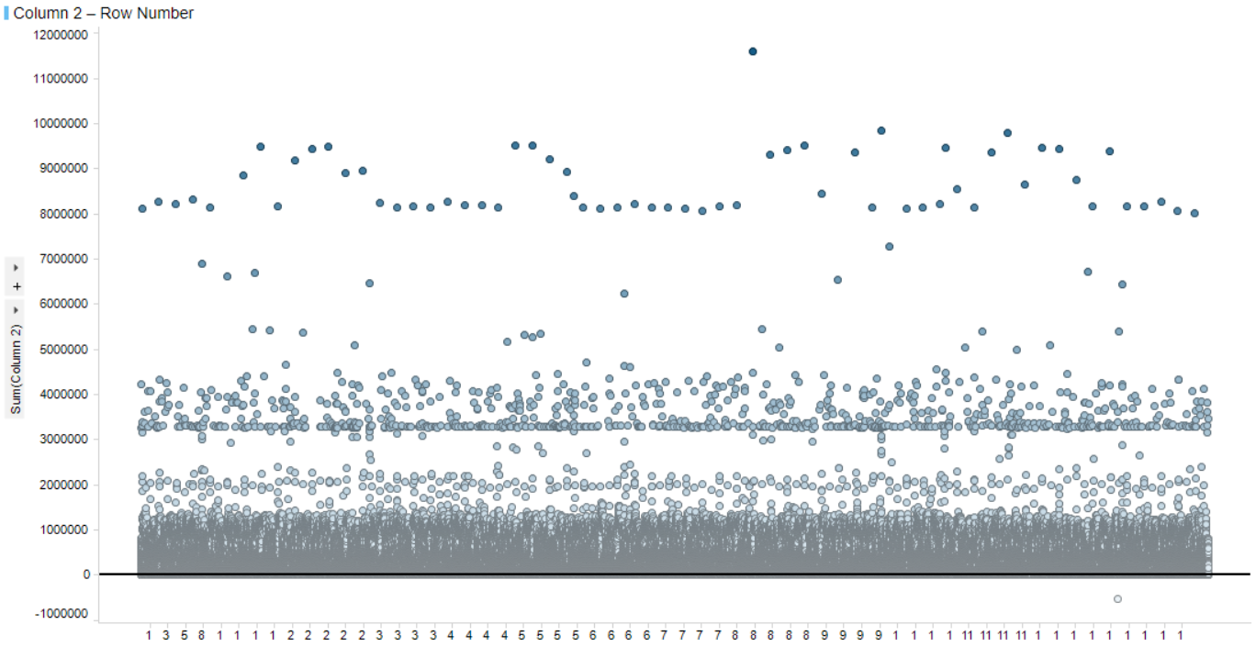
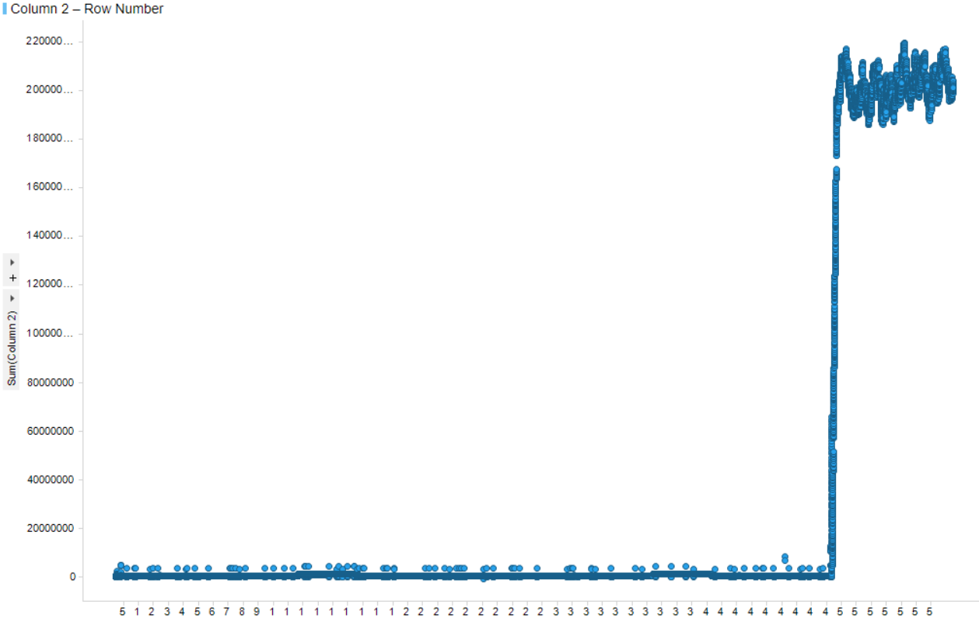
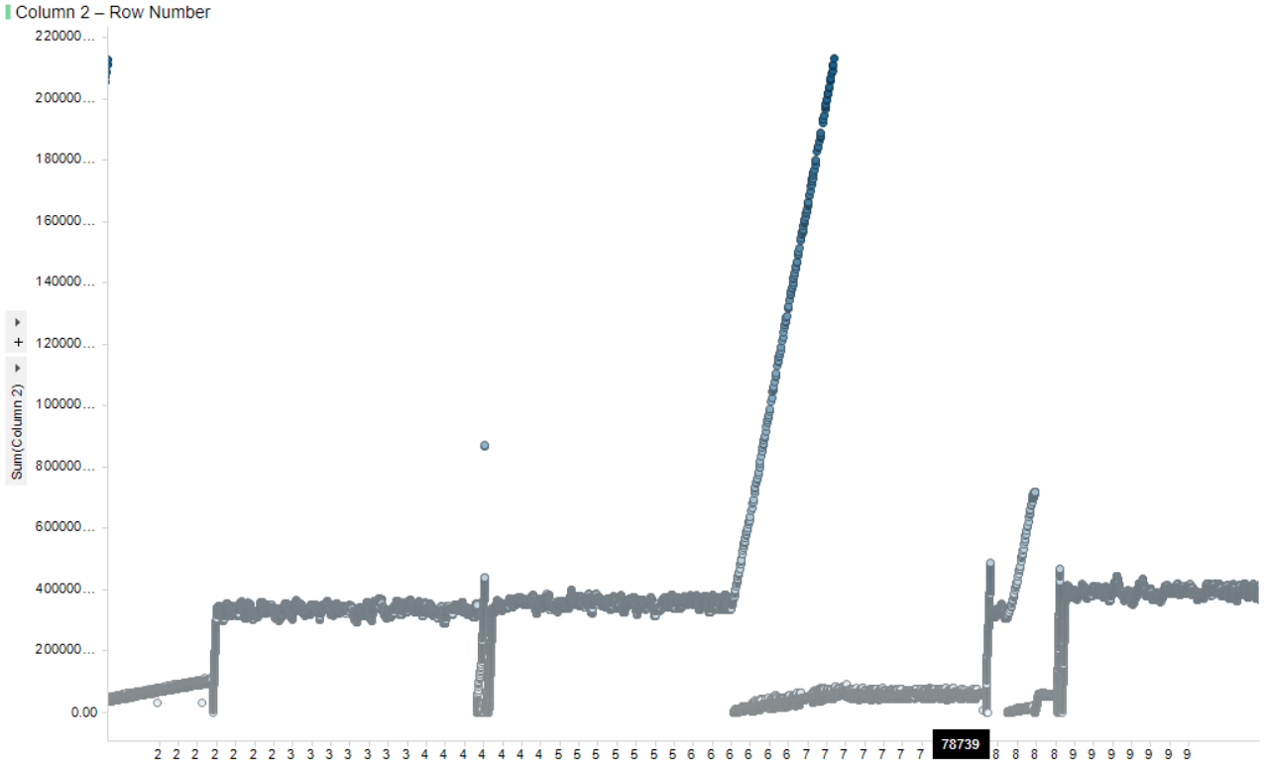
Result of Scripts: QOS
Xbox 30 secs
Big file
Test 2 – CVF
FVT
Test 1 – CVF
FVT

Slide 14
Considerations in regards to Graphs
1. Read Random or Read Sequential
2. What part of the test did I get the sample?

Slide 15
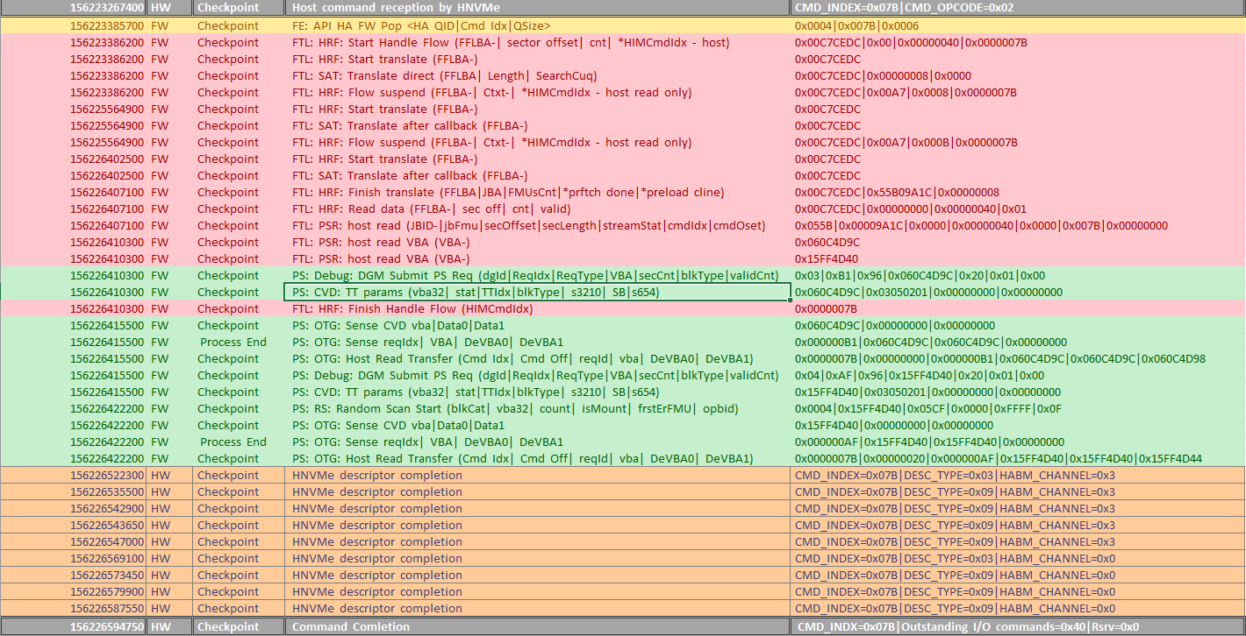
Result of Scripts: QOS (detailed)

Slide 16
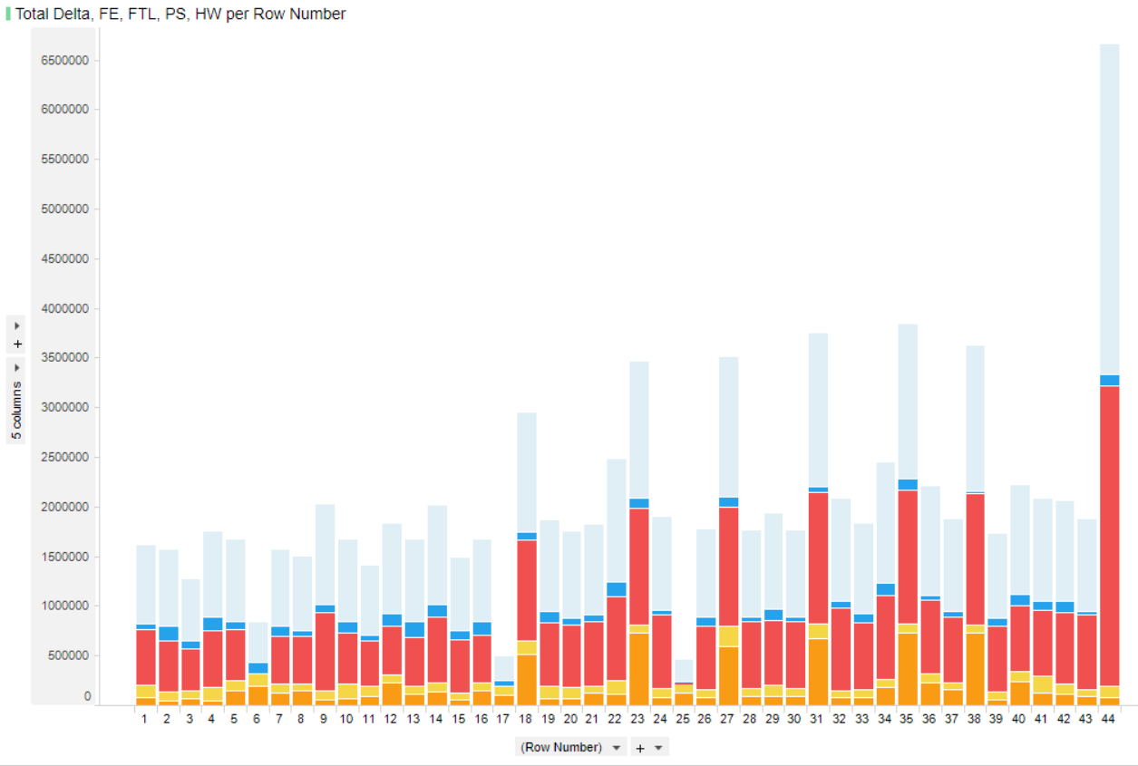
Result of Scripts: QOS (detailed) continued…

Slide 17
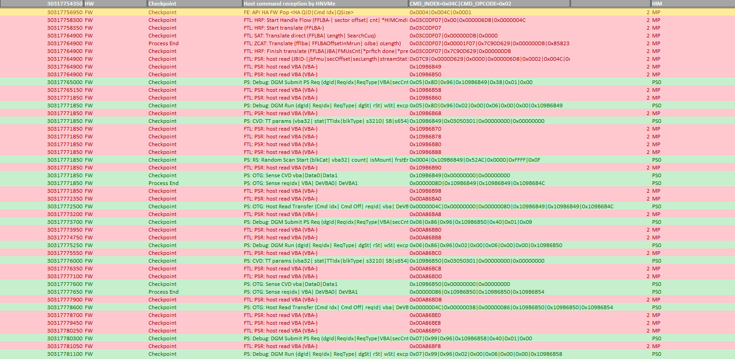
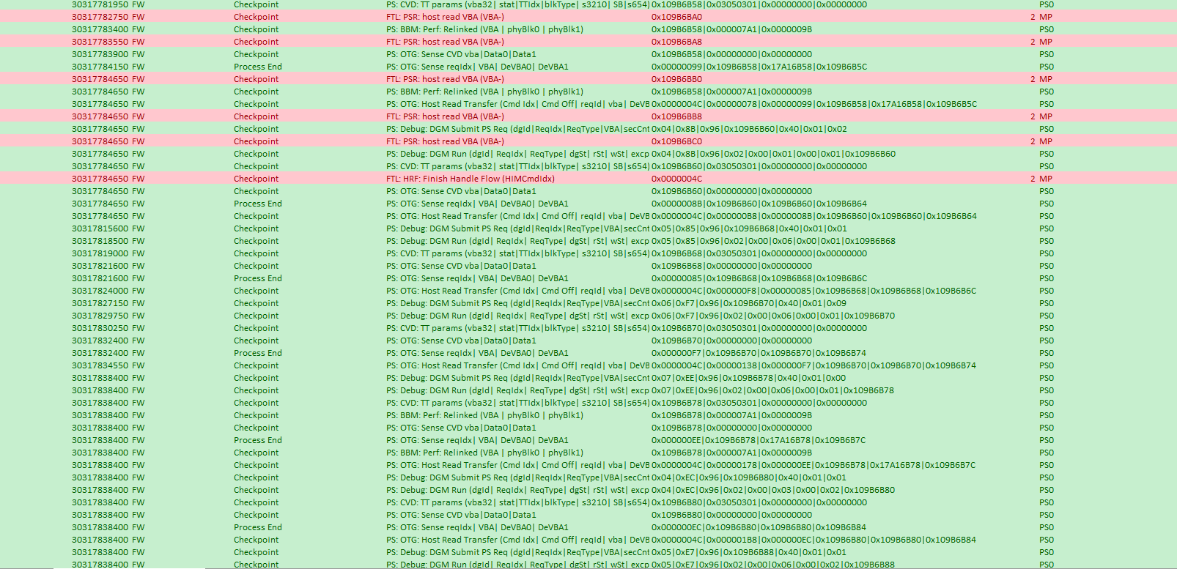
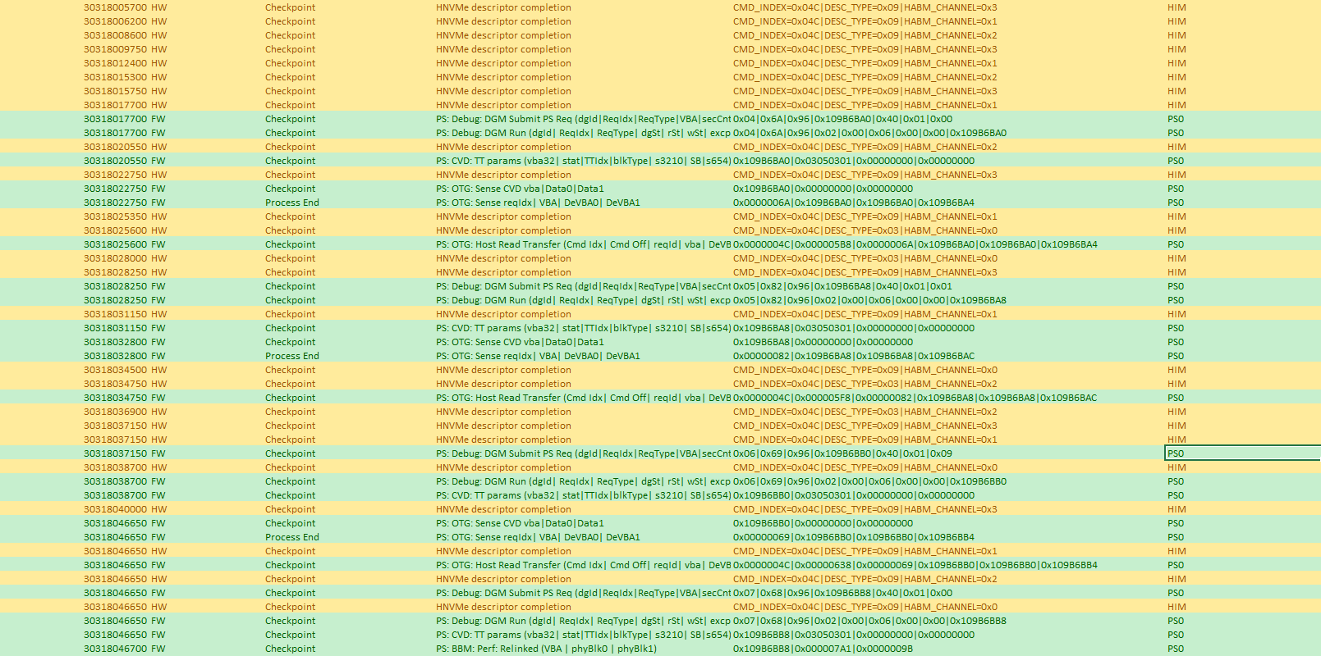
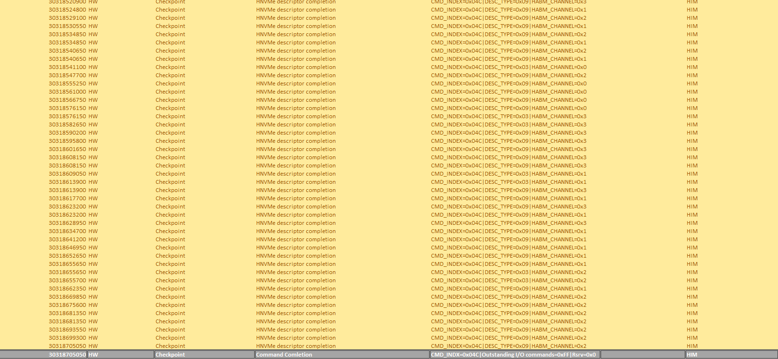
Result of Scripts: QOS (detailed) continued…

Slide 18
Understanding
Cmd rcvd
FE
FTL
FTL
PS – single threaded
FTL – sequential
PS
FTL
FTL
PS
HW
FTL
HW
PS
HW
PS
HW
HW
Cmd complete

Slide 19
Current Methodology
Test
Run xPlorer session
Run test
Filter data
Run python script
Converts into CSV
Find delta
Run python script that calculates each component of FW’s time
Converts into CSV
Display data
Import csv to Spotfire to show a stacked bar graph
Improvements?
Using java plugin in xPlorer?
Use global timestamp to link back to original data from test?
Could parse the data further by linking the PS events to specific offsets using VBA

Slide 20
Questions I have
Are the HW events important “HNVMe descriptor completion”?
Tackling the next part is what do the engineers think will be important.
As seen the stacked graph that has the totals of each component but not each different offset.
3. Should I got more detailed by splitting the PS into its separate VBA?
5. Making the script custom to the engineer, how to make config file where the engineer can pick and choose which events he/she wants to measure?

Slide 21
Config File
Trial and Error:
- Ways to make config: catch all net using cmd idx, vba, fflba
> have a start but the end doesn’t work, certain events can’t link
Be very specific, ask user for everything, event starts with link
using specific cmd index or using “cmd index”
HW EVENTS ARE HARD TO GENERALIZE!!!

